Slide 1
DS4023（2025 Fall） Machine Learning Department of Computer Science Beijing Normal-Hong Kong Baptist University

Slide 2
Chapter 4: Neural Networks

Slide 3
Outline
4.1 Neuron
4.2 Neural Network
4.3 Feedforward Neural Network
4.4 Back Propagation (BP) Algorithm
4.5 BP Examples
4.6 Computational Graph and Automatic Differentiation
4.7 Optimization Problem

Slide 4
4.1 Neuron

Slide 5

Biological neuron
A single nerve cell has only two states: excitation and inhibition.
Notes:
树突接收信号，汇聚到细胞体（包含阈值）
兴奋/抑制
兴奋之后通过轴突传给其他神经元

Slide 6
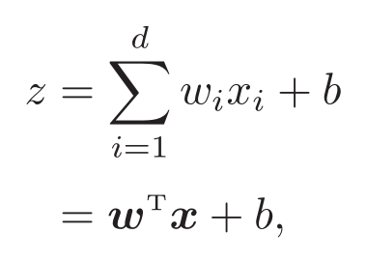
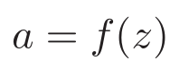
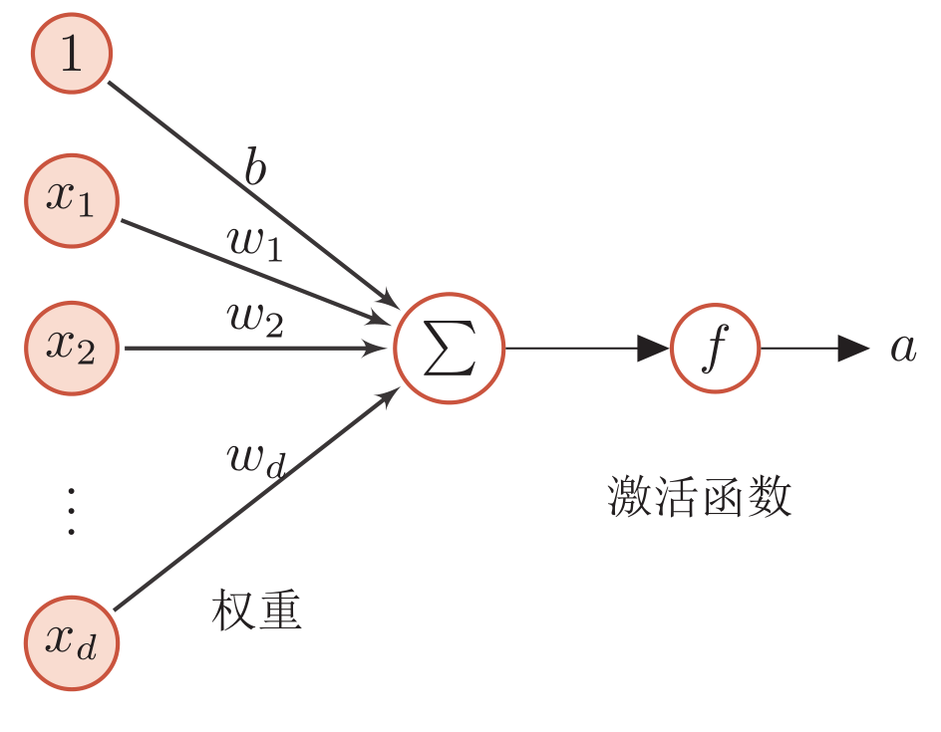
Artificial neuron
Net input
Activity value
This is a simple linear model!

Slide 7
Properties of activation function
A nonlinear function that is continuous and differentiable.
Derivable activation function can directly use numerical optimization method to learn network parameters.
Activation function and its derivative should be simple.
beneficial to improving the network computing efficiency.
The range of the derivative of the activation function should be in an appropriate interval.
Neither too big nor too small, otherwise it will affect the efficiency and stability of training.
Monotonically increasing
Maybe not. But on the whole, it is on the rise.
Notes:
神经元：收集信息，映射（激活函数）
a=f(z)

Slide 8
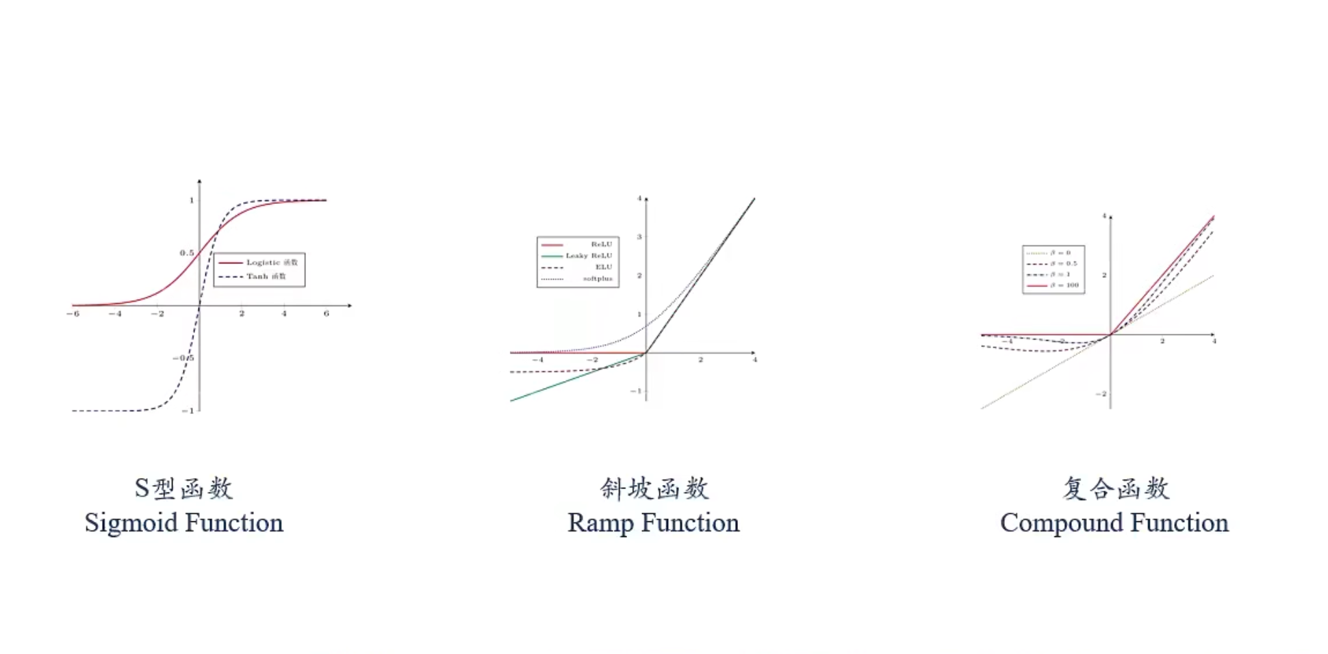
Commonly used activation function

Slide 9
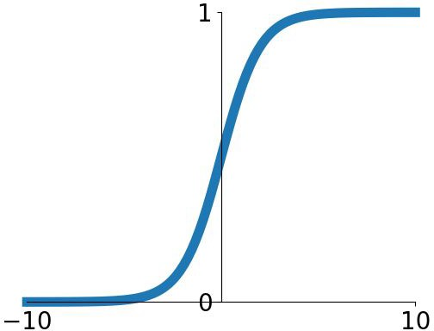
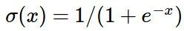
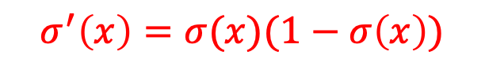
S-type: Sigmoid function
Squashes numbers to range [0,1]
Historically popular since they have nice interpretation as a saturating “firing rate” of a neuron
Sigmoid
$$σ^{′}\left(x\right)=σ(x)(1−σ\left(x\right))$$

Slide 10
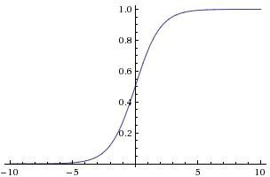
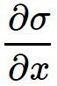
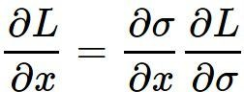
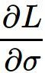
Problem: Saturated neurons “kill” the gradients
x
sigmoid gate
What happens when x = -10? What happens when x = 0?
What happens when x = 10?

Slide 11
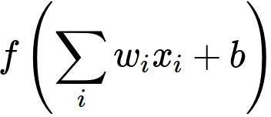

Problem: Sigmoid outputs are not zero-centered
Consider what happens when the input to a neuron is always positive...
allowed gradient update directions
allowed gradient update directions
zig zag path
What can we say about the gradients on w? Always all positive or all negative:
(this is also why you want zero-mean data!)
hypothetical optimal w vector
The output of non-zero centralization will shift the biases of neurons in the next layer and further slow the convergence speed of gradient descent.
Notes:
y=f(w\sigma(x)), dy/dw = f’(w\sigma(x))*\sigma(x), 全为正或者全为负，梯度只能在一三象限。例如w=(w1,w2),在二四象限只能走之字型。

Slide 12
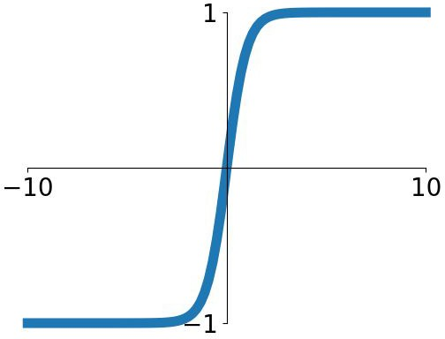
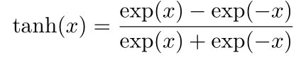
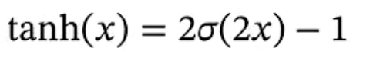
tanh(x)
Squashes numbers to range [-1,1]
zero centered (nice)
still kills gradients when saturated :

Slide 13
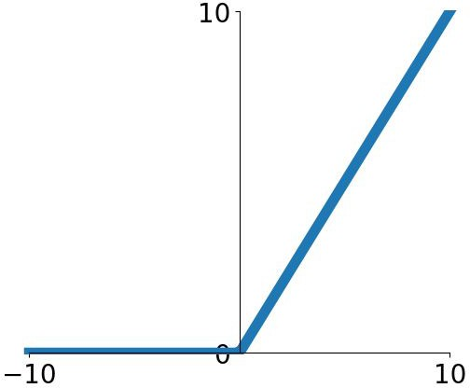
Common activation function: ramp function
- Computes f(x) = max(0,x)
Does not saturate (in +region)
Very computationally efficient
Converges much faster than sigmoid/tanh in practice (e.g. 6x)
Actually more biologically plausible
than sigmoid
Not zero-centered output
An annoyance:
hint: what is the gradient when x < 0?
ReLU
(Rectified Linear Unit)

Slide 14
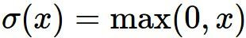
Problem
x
ReLU
gate
What happens when x = -10? What happens when x = 0?
What happens when x = 10?

Slide 15


Dead ReLU
active ReLU
DATA CLOUD
=> people like to initialize ReLU neurons with slightly positive biases (e.g. 0.01)
dead ReLU
will never activate
=> never update
Notes:
死亡ReLU问题：某个神经元在所有训练样本上都不能被激活，自身参数的梯度为0，永远无法激活。

Slide 16
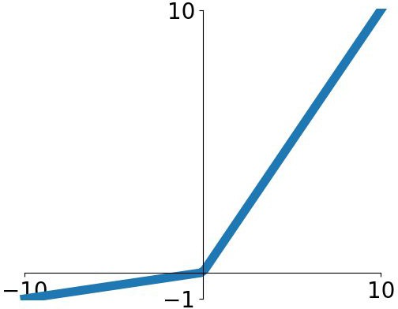
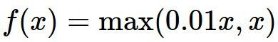
Leaky ReLU
Does not saturate
Computationally efficient
Converges much faster than sigmoid/tanh in practice! (e.g. 6x)
will not “die”.
Leaky ReLU

Slide 17
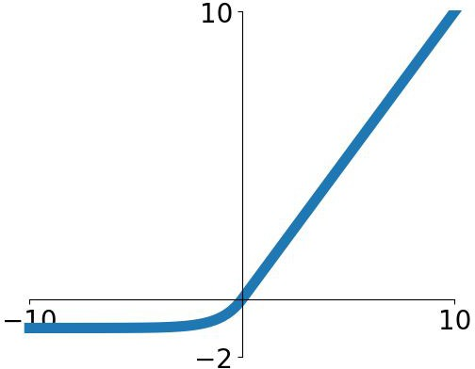
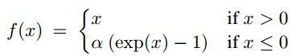
Exponential Linear Units (ELU)
All benefits of ReLU
Closer to zero mean outputs
Negative saturation regime compared with Leaky ReLU adds some robustness to noise
Computation requires exp()

Slide 18
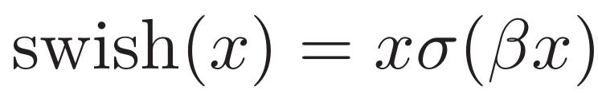
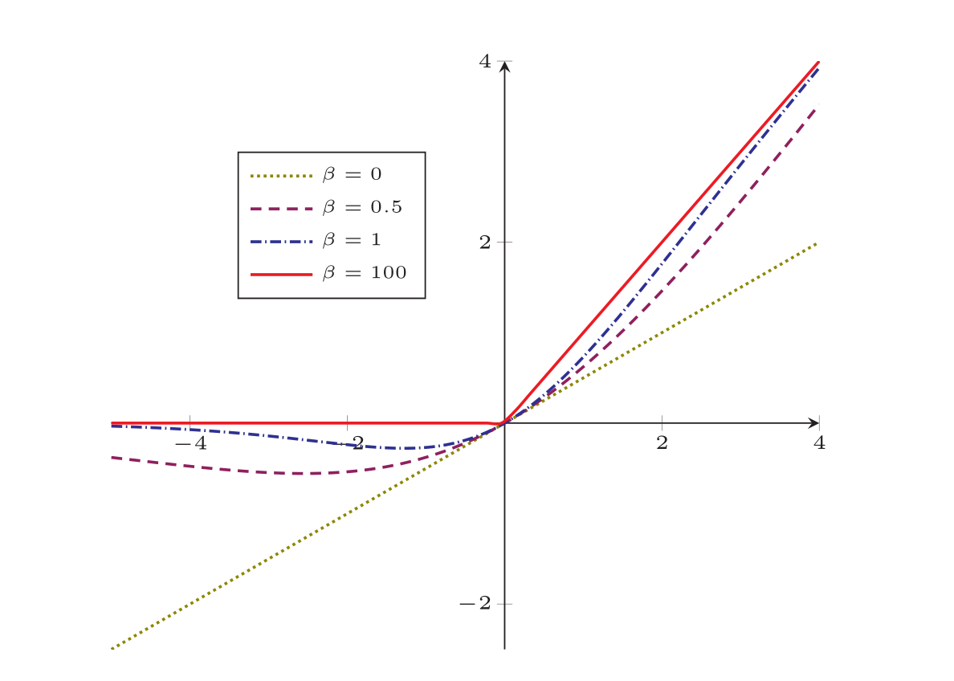
Common activation function: composite function
Swich function：a Self-gated activation function
Notes:
用sigmoid函数近似一个gate
参数\beta用于控制允许通过的信息的多少

Slide 19
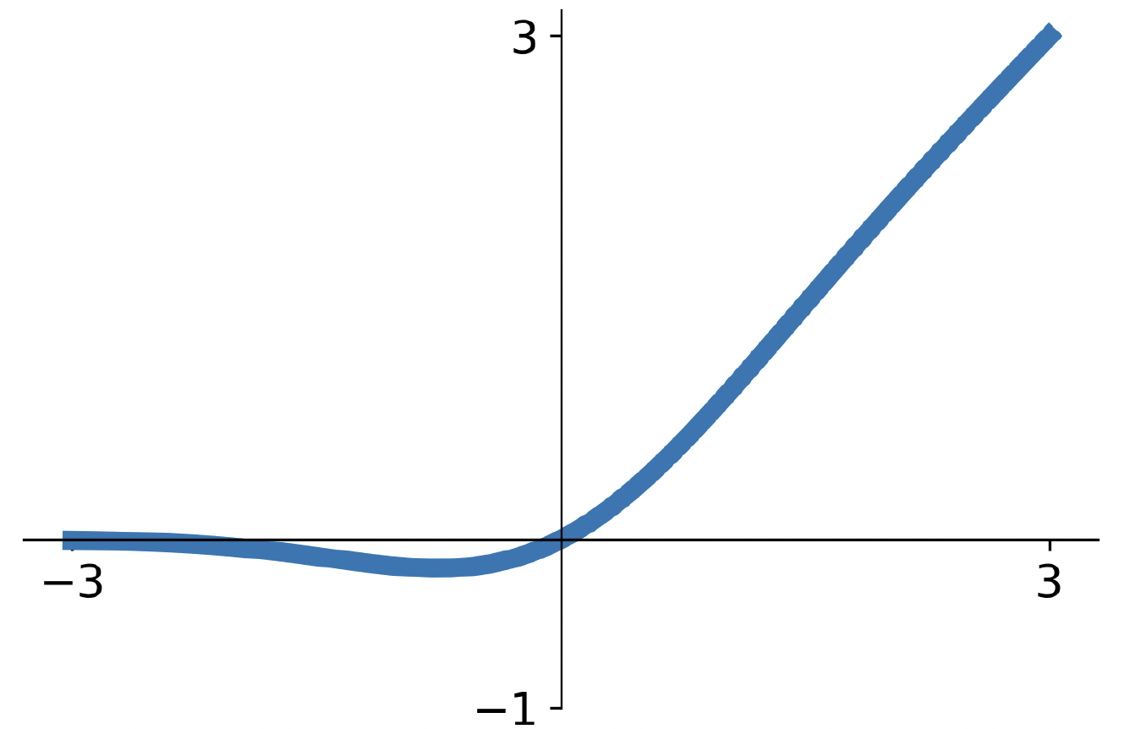
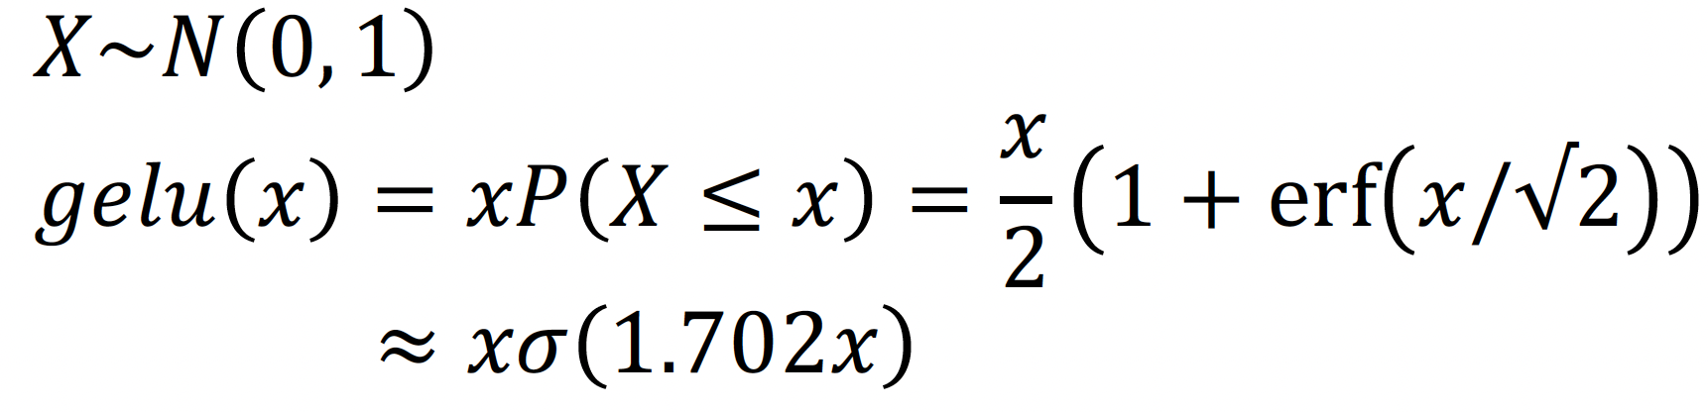
GeLU: Gaussian error linear unit
Idea: Multiply input by 0 or 1 at random; large values more likely to be multiplied by 1, small values more likely to be multiplied by 0
(data-dependent dropout)
Take expectation over randomness
Very common in Transformers (BERT, GPT, ViT)

Slide 20
In practice:
Don’t think too hard. Just use ReLU
Try out Leaky ReLU / ELU / GELU if you need to squeeze that last 0.1%
Don’t use sigmoid or tanh
Some recent architectures use GeLU instead of ReLU, but the gains are minimal
Dosovitskiy et al, “An Image is Worth 16x16 Words: Transformers for Image Recognition at Scale”, ICLR 2021 Liu et al, “A ConvNet for the 2020s”, arXiv 2022

Slide 21
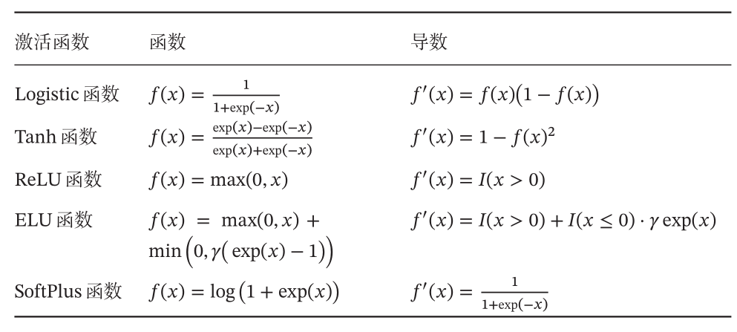
Common activation functions and their derivatives

Slide 22
4.2 Neural Network

Slide 23
Artificial Neural Network (ANN)
ANN is mainly composed of a large number of neurons and their directed connections. So consider three aspects:
Activation rules of neurons
Mainly refers to the mapping relationship between the input and output of neurons, which is generally a nonlinear function.
Topological structure of network
The connection between different neurons.
Learning Algorithm
The parameters of neural network are learned by training data.

Slide 24
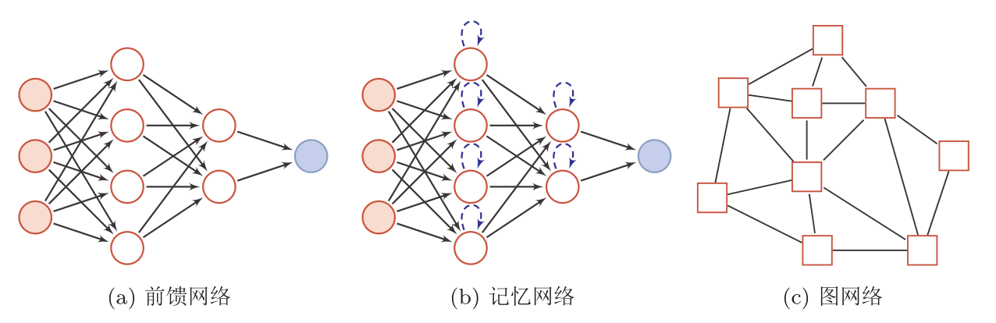
Network structure
ANN is composed of neuron model, and this information processing network composed of many neurons has a parallel distribution structure.
A circular node represents a neuron, and a square node represents a group of neurons.
Notes:
记忆网络：与状态有关
图网络：连接由图定义，每个节点是一组神经元。

Slide 25
Graph Neural Networks (GNNs)
Used for graph data structures, such as knowledge maps, social networks, molecular networks, etc.
Graph Convolutional Networks (GCN)
Kipf, T. N., & Welling, M. (2016). Semi-supervised classification with graph convolutional networks. arXiv preprint arXiv:1609.02907.
Graph Attention Networks
Veličković, P., Cucurull, G., Casanova, A., Romero, A., Lio, P., & Bengio, Y. (2017). Graph attention networks. arXiv preprint arXiv:1710.10903.
GNN with mini-batch training
Hamilton, Will, Zhitao Ying, and Jure Leskovec. "Inductive representation learning on large graphs." Advances in neural information processing systems 30 (2017).

Slide 26
Neural network (NN)
NN was originally used as a main connectionist model.
In the late 1980s, one of the most popular connectionist models was the Parallel Distributed Processing (PDP) network, which had three main characteristics:
1）Information representation is distributed (non-local)
2）Memory and knowledge are stored in the connections between units
3）Learn new knowledge by gradually changing the connection strength between units.
After introducing error back propagation to improve its learning ability, neural networks are increasingly applied to various machine learning tasks.

Slide 27
4.3 Feedforward Neural Network

Slide 28
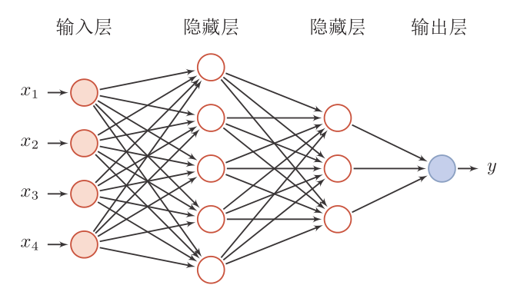
Network structure
Feedforward NN (fully connected NN, multilayer perceptron)
Each neuron belongs to different layers, and there is no connection in the layers.
The neurons between two adjacent layers are connected in pairs.
There is no feedback, and the signal propagates unidirectionally from input to output layer, a directed acyclic graph.

Slide 29
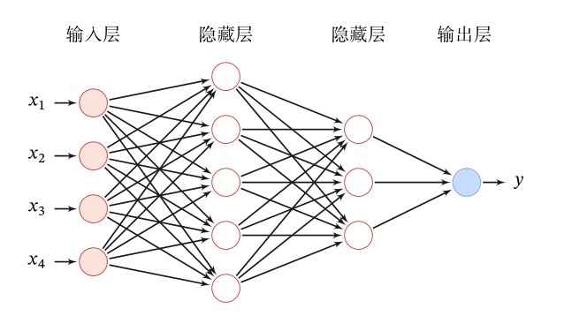
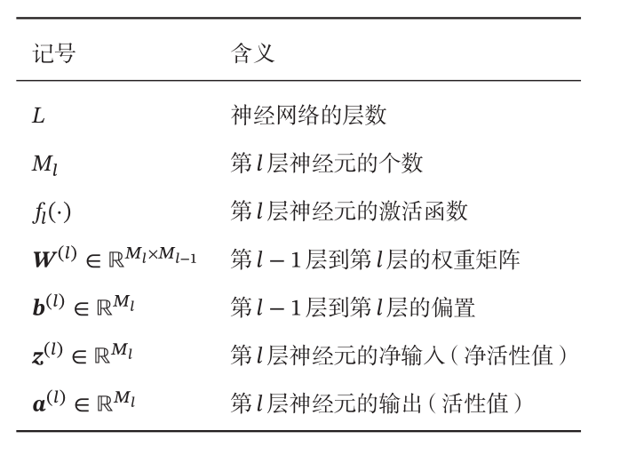
Feedforward Neural Network (FNN)
Given a feedforward neural network, the following notations are used to describe such a network:

Slide 30
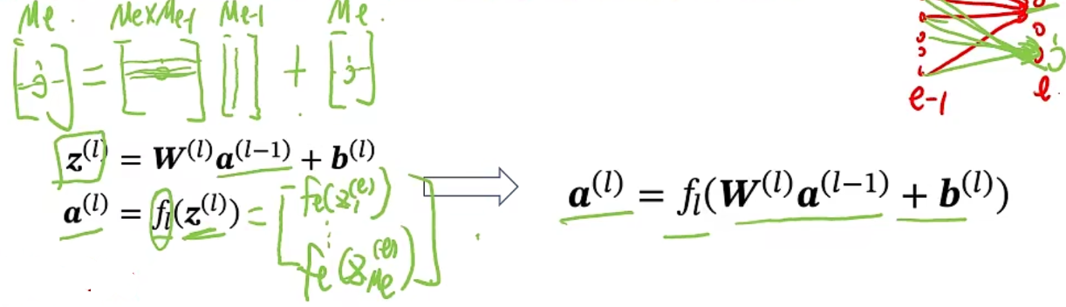
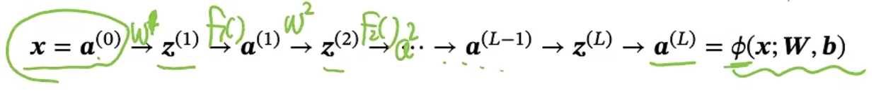
Information Propagation Process
FNN spreads information through the following formula:
Forward calculation:

Slide 31
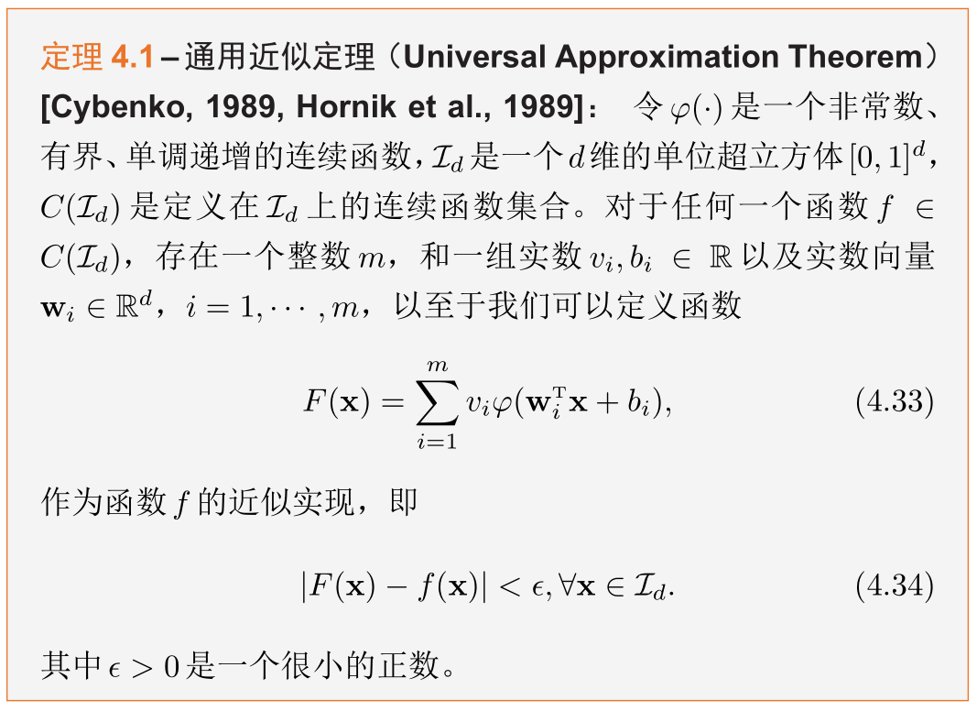
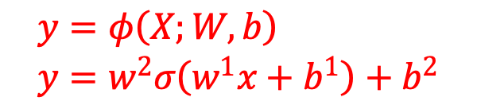
Universal Approximation Theorem
$$y=φ\left(X;W,b\right) \\ y=w^{2}σ\left(w^{1}x+b^{1}\right)+b^{2}$$
Thinking: Can a two-layer ReLU network simulate any bounded closed set function?
According to the universal approximation theorem, a feedforward neural network consisting of a linear output layer and at least one hidden layer using the "squeezing" property can approximate any bounded closed set function defined in real number space with arbitrary accuracy as long as the number of neurons in the hidden layer is sufficient.
Notes:
神经网络的通用近似性质也被证明对于其它类型的激活函数，比如ReLU，也都是适用的。

Slide 32
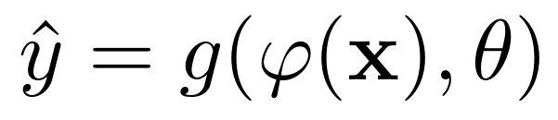
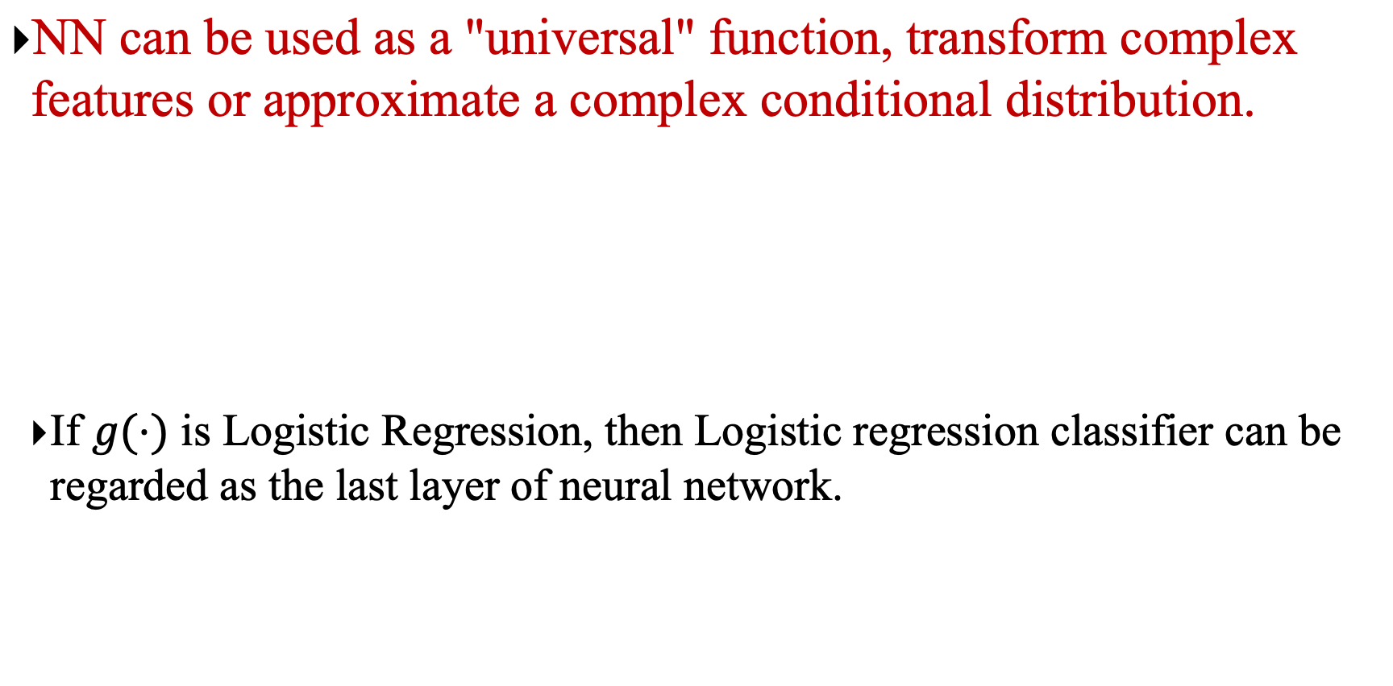
Applied to Machine Learning
NN can be used as a "universal" function, transform complex features or approximate a complex conditional distribution.
If $g(⋅)$ is Logistic Regression, then Logistic regression classifier can be regarded as the last layer of neural network.
classifier
Neural networks
Notes:
特征抽取

Slide 33
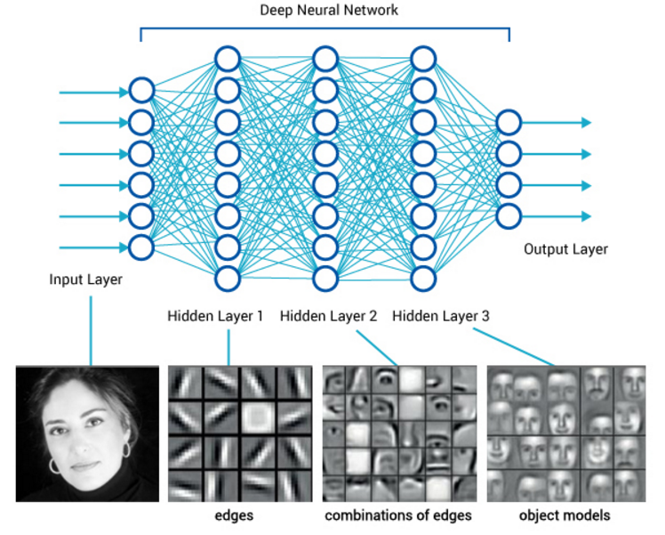
Deep Feedforward Neural Network

Slide 34
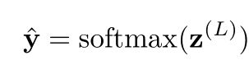
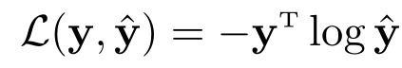
Parameter Learning
For multi-classification problems
If Softmax regression classifier is used, it is equivalent to setting C neurons in the last layer, and its output is conditional probability of each class after being normalized by Softmax function.
Using the cross entropy loss function, for the sample (x,y), the loss function is
Notes:
Softmax可看作一种特殊的激活函数。
y\in{0,1}^C

Slide 35
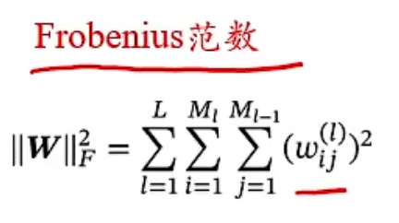
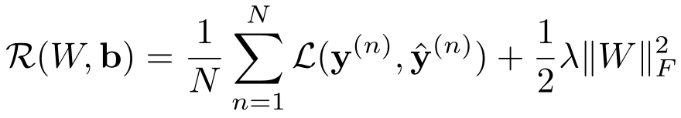
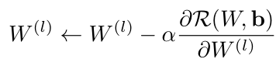
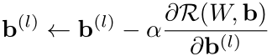
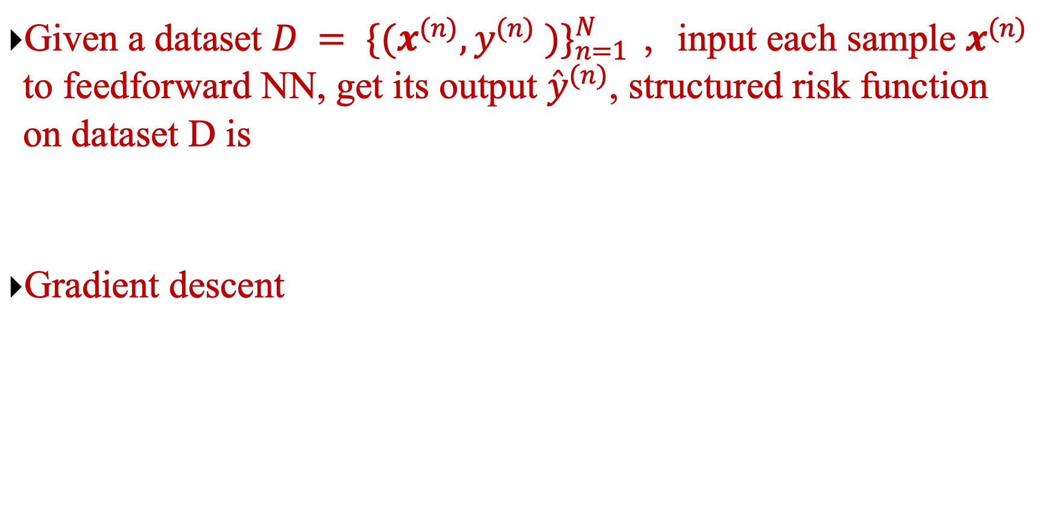
Parameter Learning
Given a dataset $D = {\{(x^{(n)},y^{(n)} )\}}_{n=1}^{N }$ ，input each sample $x^{(n)}$ to feedforward NN, get its output ${\hat{y}}^{(n)}$, structured risk function on dataset D is
Gradient descent

Slide 36
How to calculate the gradient?
Neural network is a complex compound function.
Chain rule
Back propagation algorithm
An efficient method designed according to the characteristics of feedforward network
A more general calculation method
Automatic Differentiation (AD)
$y=f5(f4(f3(f2(f1\left(x\right)))))$ → $\frac{∂y}{∂x}=\frac{∂f1}{∂x}\frac{∂f2}{∂f1}\frac{∂f3}{∂f2}\frac{∂f4}{∂f3}\frac{∂f5}{∂f4}$

Slide 37
4.4 Back Propagation Algorithm

Slide 38
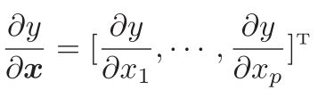
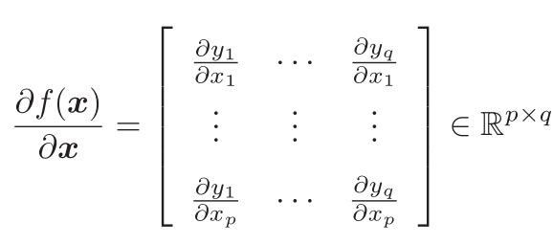
Matrix Calculus
An expression of multivariate calculus: using matrices and vectors to represent partial derivatives of each component of the dependent variable w.r.t each component of the independent variable.
Denominator Layout (Column Vector)
Partial derivative of scalar with respect to vector
Partial derivative of vector with respect to vector

Slide 39
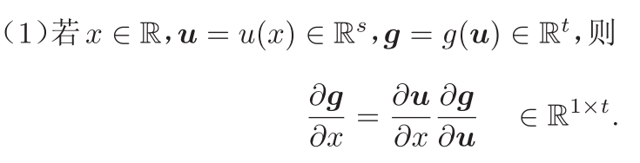
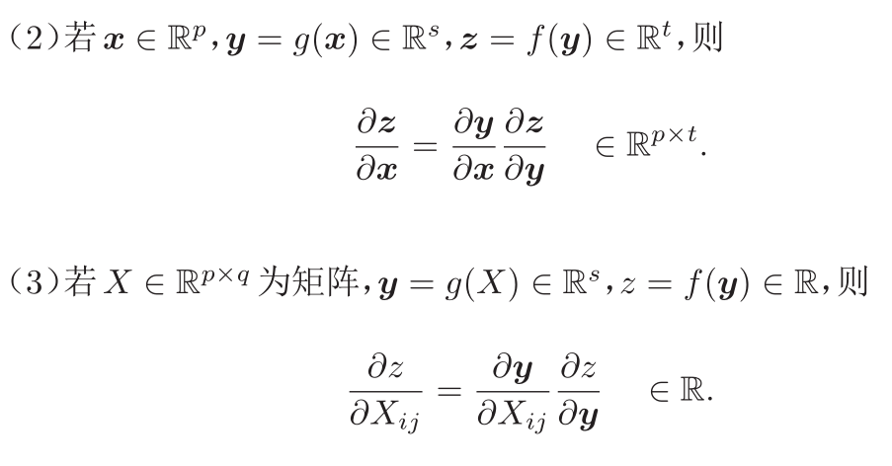
Chain rule
Chain Rule is a common method to find the derivative of compound function in calculus.

Slide 40
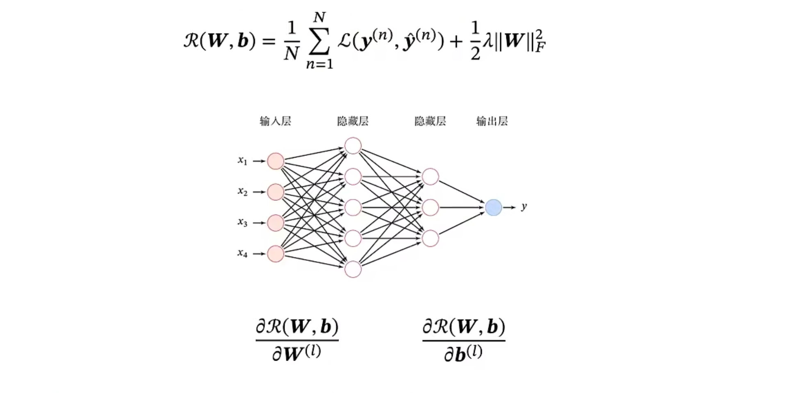
Compute Gradient

Slide 41
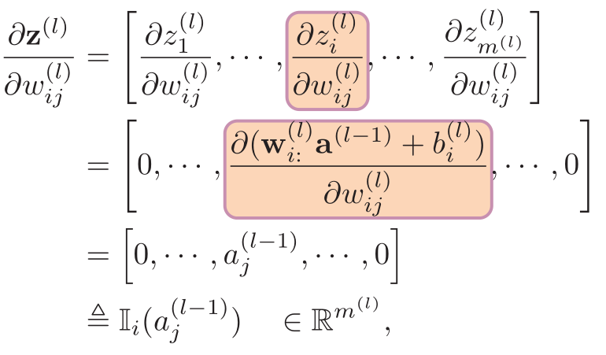






Compute Gradient
$$ℝ^{1×M_{l}}$$
Error term
Here $m^{(l)}$ refers to the number of neurons in the $l$-th layer, namely $m_{l}$

Slide 42








Compute
$$∈ℝ^{M_{l}×M_{l+1}}$$
$$∈ℝ^{M_{l}×M_{l}}$$
Back propagation
$$∈ℝ^{M_{l}}$$

Slide 43

Compute Gradient

Slide 44

Stochastic gradient descent training process

Slide 45
4.5 BP Examples

Slide 46


Backpropagation: a simple example
Reference: Stanford CS231n

Slide 47






Backpropagation: a simple example
e.g. x = -2, y = 5, z = -4
1
Want:
Reference: Stanford CS231n

Slide 48

Backpropagation: a simple example
e.g. x = -2, y = 5, z = -4
1
3
Want:
Reference: Stanford CS231n

Slide 49

Backpropagation: a simple example
e.g. x = -2, y = 5, z = -4
-4
1
3
Want:
Reference: Stanford CS231n

Slide 50



Backpropagation: a simple example
e.g. x = -2, y = 5, z = -4
-4
-4
1
3
Chain rule:
Want:
Upstream gradient
Local gradient
Reference: Stanford CS231n

Slide 51

Backpropagation: a simple example
-4
e.g. x = -2, y = 5, z = -4
-4
-4
1
3
Chain rule:
Want:
Upstream gradient
Local gradient
Reference: Stanford CS231n

Slide 52







Backpropagation: a simple example
“local gradient”
f
“Downstream gradients”
“Upstream
gradient”

Slide 53


Another example

Slide 54
Another example

Slide 55


Another example

Slide 56
Another example

Slide 57

Another example
Upstream gradient
Local gradient

Slide 58
Another example

Slide 59
Another example
Upstream gradient
Local gradient

Slide 60
Another example

Slide 61
Another example
Upstream gradient
Local gradient

Slide 62
Another example

Slide 63
Another example
Upstream gradient
Local gradient

Slide 64
Another example

Slide 65
Another example
[upstream gradient] x [local gradient] [0.2] x [1] = 0.2
[0.2] x [1] = 0.2 (both inputs!)

Slide 66
Another example

Slide 67

Another example
[upstream gradient] x [local gradient] w0: [0.2] x [-1] = -0.2
x0: [0.2] x [2] = 0.4

Slide 68

Another example
Computational graph representation may not be unique. Choose one where local gradients at each node can be easily expressed!
Sigmoid function
Sigmoid
Sigmoid local gradient:

Slide 69
Another example
Computational graph representation may not be unique. Choose one where local gradients at each node can be easily expressed!
Sigmoid function
Sigmoid
[upstream gradient] x [local gradient] [1.00] x [(1 - 1/(1+e⁻¹)) (1/(1+e⁻¹))] = 0.2
Sigmoid local gradient:

Slide 70
Another example
Computational graph representation may not be unique. Choose one where local gradients at each node can be easily expressed!
Sigmoid function
Sigmoid
[upstream gradient] x [local gradient] [1.00] x [(1 - 0.73) (0.73)] = 0.2
Sigmoid local gradient:

Slide 71
Patterns in gradient flow
add gate: gradient distributor 3
mul gate: “swap multiplier” 2
2
4
7
5*3=15
3
6
+
×
2
5
2
copy gate: gradient adder
7
7
4+2=6
2*5=10
max gate: gradient router 4
4
7
0
5
5
max
9
2
9

Slide 72



Backprop implementation
Forward pass: Compute output
Backward pass: Compute grads

Slide 73
Backprop implementation
Forward pass: Compute output
Base case

Slide 74
Backprop implementation
Forward pass: Compute output
Sigmoid

Slide 75
Backprop implementation
Forward pass: Compute output
Add gate

Slide 76
Backprop implementation
Forward pass: Compute output
Add gate

Slide 77
Backprop implementation
Forward pass: Compute output
Multiply gate

Slide 78
Backprop implementation
Forward pass: Compute output
Multiply gate

Slide 79
So far: backprop with scalars
What about vector-valued functions?

Slide 80








Recap: Vector derivatives
Scalar to Scalar
Vector to Scalar
Vector to Vector
Regular derivative:
Derivative is Gradient:
Derivative is Jacobian:
If x changes by a small amount, how much will y change?
For each element of x, if it changes by a small amount then how much will y change?
For each element of x, if it changes by a small amount then how much will each element of y change?

Slide 81

Backprop with Vectors
Loss L still a scalar!
f

Slide 82
Backprop with Vectors
D_{x}
Loss L still a scalar!
D_{z}
f
D_{y}

Slide 83
Backprop with Vectors
D_{x}
Loss L still a scalar!
D_{z}
f
D_{y}
“Upstream gradient”

Slide 84
Backprop with Vectors
D_{x}
Loss L still a scalar!
D_{z}
f
D_{z}
D_{y}
“Upstream gradient” For each element of z, how much does it influence L?

Slide 85


Backprop with Vectors
D_{x}
Loss L still a scalar!
“local gradients”
D_{z}
f
“Downstream
gradients”
D_{z}
D_{y}
“Upstream gradient” For each element of z, how much does it influence L?

Slide 86
Backprop with Vectors
D_{x}
Loss L still a scalar!
“local gradients”
[D_{x} x D_{z}]
f
[D_{y} x D_{z}]
Jacobian matrices
D_{z}
“Downstream
gradients”
D_{z}
D_{y}
“Upstream gradient” For each element of z, how much does it influence L?

Slide 87
Backprop with Vectors
D_{x}
Loss L still a scalar!
“local gradients”
[D_{x} x D_{z}]
f
D_{x}
D_{z}
“Downstream
gradients”
Matrix-vector multiply
[D x D ]
D_{z}
D_{y}
y z
Jacobian matrices
“Upstream gradient” For each element of z, how much does it influence L?
D_{y}

Slide 88


Gradients of variables wrt loss have same dims as the original variable
Loss L still a scalar!
D_{x}
D_{x}
D_{z}
f
D_{z}
D_{y}
“Upstream gradient” For each element of z, how much does it influence L?
D_{y}

Slide 89
Backprop with Vectors
4D input x:
4D output z:
[ 1 ]
[ -2 ]
[ 3 ]
[ -1 ]
f(x) = max(0,x)
(elementwise)
[ 1 ]
[ 0 ]
[ 3 ]
[ 0 ]
Jacobian dz/dx [ 1 0 0 0 ]
[ 0 0 0 0 ]
[ 0 0 1 0 ]
4D dL/dz:
[ 4 ]
[ -1 ]
[ 5 ]
Upstream gradient
[ 0 0 0 0 ]
[ 9 ]

Slide 90
Backprop with Vectors
4D input x:
4D output z:
[ 1 ]
[ -2 ]
[ 3 ]
[ -1 ]
f(x) = max(0,x)
(elementwise)
[ 1 ]
[ 0 ]
[ 3 ]
[ 0 ]
Jacobian is sparse: off-diagonal entries always zero! Never explicitly form Jacobian -- instead use implicit multiplication
4D dL/dx: [ 4 ]
[ 0 ]
[ 5 ]
[ 0 ]
[dz/dx] [dL/dz] [ 1 0 0 0 ] [ 4 ]
[ 0 0 0 0 ] [ -1 ]
[ 0 0 1 0 ] [ 5 ]
[ 0 0 0 0 ] [ 9 ]
4D dL/dz:
[ 4 ]
[ -1 ]
[ 5 ]
[ 9 ]
Upstream gradient

Slide 91

Backprop with Vectors
4D input x:
4D output z:
[ 1 ]
[ -2 ]
[ 3 ]
[ -1 ]
f(x) = max(0,x)
(elementwise)
[ 1 ]
[ 0 ]
[ 3 ]
[ 0 ]
Jacobian is sparse: off-diagonal entries always zero! Never explicitly form Jacobian -- instead use implicit multiplication
4D dL/dx: [ 4 ]
[ 0 ]
[ 5 ]
[ 0 ]
[dz/dx] [dL/dz]
4D dL/dz:
[ 4 ]
[ -1 ]
[ 5 ]
[ 9 ]
z
Upstream gradient

Slide 92
Backprop with Matrices (or Tensors)
Loss L still a scalar!
[D_{x}×M_{x}]
dL/dx always has the same shape as x!
[D_{z}×M_{z}]
f
Jacobian matrices
Matrix-vector multiply
[D_{y}×M_{y}]

Slide 93


Backprop with Matrices (or Tensors)
Loss L still a scalar!
[D_{x}×M_{x}]
[D_{x}×M_{x}]
dL/dx always has the same shape as x!
[D_{z}×M_{z}]
f
Jacobian matrices
“Downstream
gradients”
Matrix-vector multiply
[D_{y}×M_{y}]
[D_{z}×M_{z}]
“Upstream gradient” For each element of z, how much does it influence L?
[D_{y}×M_{y}]

Slide 94

Backprop with Matrices (or Tensors)
Loss L still a scalar!
[D_{x}×M_{x}]
[D_{x}×M_{x}]
dL/dx always has the same shape as x!
[D_{z}×M_{z}]
“local gradients”
“Downstream
gradients”
Matrix-vector multiply
[D_{y}×M_{y}]
[D_{y}×M_{y}]
[D_{z}×M_{z}]
“Upstream gradient” For each element of z, how much does it influence L?
Jacobian matrices
For each element of y, how much does it influence each element of z?

Slide 95
Backprop with Matrices
Loss L still a scalar!
[D_{x}×M_{x}]
[D_{x}×M_{x}]
dL/dx always has the same shape as x!
“local gradients”
[(D_{x}×M_{x})×(D_{z}×M_{z})]
[D_{z}×M_{z}]
“Downstream
gradients”
Matrix-vector multiply
[(D_{y}×M_{y})×(D_{z}×M_{z})]
[D_{y}×M_{y}]
[D_{z}×M_{z}]
Jacobian matrices
“Upstream gradient” For each element of z, how much does it influence L?
[D_{y}×M_{y}]
For each element of y, how much does it influence each element of z?

Slide 96

Backprop with Matrices
y: [N×M]
[13 9 -2 -6 ]
[ 5 2 17 1 ]
x: [N×D]
Matrix Multiply
[ 2 1 -3 ]
[ -3 4 2 ]
dL/dy: [N×M] [ 2 3 -3 9 ]
[ -8 1 4 6 ]
w: [D×M]
[ | 3 | 2 | 1 -1]
[ | 2 | 1 | 3 2]
[ | 3 | 2 | 1 -2]
Jacobians: dy/dx: [(N×D)×(N×M)]
dy/dw: [(D×M)×(N×M)]
For a neural net we may have N=64, D=M=4096
Each Jacobian takes ~256 GB of memory! Must work with them implicitly!

Slide 97
Backprop with Matrices
y: [N×M]
[13 9 -2 -6 ]
[ 5 2 17 1 ]
x: [N×D]
Matrix Multiply
[ 2 1 -3 ]
[ -3 4 2 ]
dL/dy: [N×M] [ 2 3 -3 9 ]
[ -8 1 4 6 ]
w: [D×M]
[ 3 2 1 -1]
[ 2 1 3 2]
[ 3 2 1 -2]
Q: What parts of y are affected by one element of x?

Slide 98



Backprop with Matrices
y: [N×M]
[13 9 -2 -6 ]
[ 5 2 17 1 ]
x: [N×D]
Matrix Multiply
[ 2 1 -3 ]
[ -3 4 2 ]
dL/dy: [N×M] [ 2 3 -3 9 ]
[ -8 1 4 6 ]
w: [D×M]
[ 3 2 1 -1]
[ 2 1 3 2]
[ 3 2 1 -2]
Q: What parts of y are affected by one element of x?
A: affects the whole row

Slide 99

Backprop with Matrices
y: [N×M]
[13 9 -2 -6 ]
[ 5 2 17 1 ]
x: [N×D]
Matrix Multiply
[ 2 1 -3 ]
[ -3 4 2 ]
dL/dy: [N×M] [ 2 3 -3 9 ]
[ -8 1 4 6 ]
w: [D×M]
[ 3 2 1 -1]
[ 2 1 3 2]
[ 3 2 1 -2]
Q: What parts of y are affected by one element of x?
Q: How much
does
affect ?
A: affects the whole row

Slide 100


Backprop with Matrices
y: [N×M]
[13 9 -2 -6 ]
[ 5 2 17 1 ]
x: [N×D]
Matrix Multiply
[ 2 1 -3 ]
[ -3 4 2 ]
dL/dy: [N×M] [ 2 3 -3 9 ]
[ -8 1 4 6 ]
w: [D×M]
[ 3 2 1 -1]
[ 2 1 3 2]
[ 3 2 1 -2]
Q: What parts of y are affected by one element of x?
Q: How much
does
affect ?
A: affects the
A:
whole row

Slide 101

Backprop with Matrices
y: [N×M]
[13 9 -2 -6 ]
[ 5 2 17 1 ]
x: [N×D]
Matrix Multiply
[ 2 1 -3 ]
[ -3 4 2 ]
dL/dy: [N×M] [ 2 3 -3 9 ]
[ -8 1 4 6 ]
w: [D×M]
[ 3 2 1 -1]
[ 2 1 3 2]
[ 3 2 1 -2]
Q: What parts of y are affected by one element of x?
Q: How much
does
affect ?
A: affects the
A:
[N×D] [N×M] [M×D]
whole row

Slide 102

Backprop with Matrices
y: [N×M]
[13 9 -2 -6 ]
[ 5 2 17 1 ]
x: [N×D]
Matrix Multiply
[ 2 1 -3 ]
[ -3 4 2 ]
dL/dy: [N×M] [ 2 3 -3 9 ]
[ -8 1 4 6 ]
w: [D×M]
[ 3 2 1 -1]
[ 2 1 3 2]
[ 3 2 1 -2]
By similar logic:
[N×D] [N×M] [M×D]
[D×M] [D×N] [N×M]
These formulas are easy to remember: they are the only way to make shapes match up!

Slide 103
4.6 Computational Graph and Automatic Differentiation

Slide 104


Computational Graph and Automatic Differentiation
AD is to use the chain rule to automatically calculate the gradient of a compound function.
Computational graph
Notes:
当x=1,w=0,b=0时复合函数的计算图

Slide 105


Computational graph

Slide 106

Automatic Differentiation (AD)
Forward mode and backward mode
If there are multiple paths between the function and the parameter, the derivatives on these multiple paths can be added to get the final gradient.
Notes:
有什么差异？
前向模式需要保留中间变量
前向模式按计算图中计算方向的相同方向递归地计算梯度。

Slide 107


Forward Mode

Slide 108

Backward Mode

Slide 109

PyTorch Example

Slide 110
Back propagation algorithm (reverse mode of AD)
The training process of feedforward neural network can be divided into the following three steps:
Forward calculate the status and activation value of each layer until the last layer.
Backward calculate the partial derivatives of the parameters of each layer.
Update parameters

Slide 111
Static/Dynamic Computational Graph
Static CG built at compile time, which cannot be changed when the program is running after it is built.
Theano and Tensorflow
Dynamic CG is dynamically constructed when the program is running.
DyNet，Chainer, and PyTorch
Advantages and disadvantages:
Static CG can be optimized when it is built, and it has strong parallel ability, but its flexibility is poor.
Dynamic CG is not easy to optimize, and difficult to calculate in parallel when the network structures of different inputs are inconsistent, but it is flexible.

Slide 112

How to achieve it?

Slide 113
Getting started: 30 seconds to Keras
from keras.models import Sequential
from keras.layers import Dense, Activation
from keras.optimizers import SGD
model = Sequential()
model.add(Dense(output_dim=64, input_dim=100))
model.add(Activation("relu"))
model.add(Dense(output_dim=10))
model.add(Activation("softmax"))
model.compile(loss='categorical_crossentropy',
optimizer='sgd', metrics=['accuracy'])
model.fit(X_train, Y_train, nb_epoch=5, batch_size=32)
loss = model.evaluate(X_test, Y_test, batch_size=32)
Notes:
又在tensorflow上进行一层封装

Slide 114

Three Steps of Deep Learning
1
2
3
定义网络
损失函数
优化
Deep Learning is so simple ……

Slide 115
4.7 Optimization Problem

Slide 116

Optimization Problem
Nonconvex optimization problem
$$Y=σ\left(w_{2}σ\left(w_{1}x\right)\right)$$

Slide 117



Gradient Descent
Gradient：$\frac{∂f(w)}{∂ w}=\lim_{Δw→0}{\frac{f(w+Δw)}{Δw}}$
Initialize w
Repeat
Calculate gradient ${∂ℒ}/{∂w}$
Update $w←w−α$ ${∂ℒ}/{∂w}$
Loss $ℒ$
Network Parameters
Notes:
Consider a parameter w in $θ$

Slide 118



Optimization Problem
Vanishing Gradient Problem
$y=f5(f4(f3(f2(f1\left(x\right)))))$
$$\frac{∂y}{∂x}=\frac{∂f1}{∂x}\frac{∂f2}{∂f1}\frac{∂f3}{∂f2}\frac{∂f4}{∂f3}\frac{∂f5}{∂f4}$$
Error Back Propagation：
Notes:
导数在合理范围内，1左右最好，ReLU好

Slide 119
Optimization Problem
Difficulty
Nonconvex optimization problem: there is a local optimal solution rather than a global optimal solution, which affects iteration
Vanishing Gradient Problem, lower parms are difficult to adjust
Too many parameters affect training
Parameters are difficult to interpret
Demand
Large computational resource
More data
Efficiency of algorithm is good: convergence is fast

